Slide 1
FREE STATE PROVINCIAL TREASURY MAFUBE LOCAL MUNICIPALITY - FINANCIAL RECOVERY PLAN
05 September 2023

Slide 2
PRESENTATION LAYOUT
Purpose
Legislative requirements
Legislative requirements and process
Intention of the intervention
Municipal support and intervention model
Methodology applied (Support towards intervention)
Diagnostics of Mafube Local Municipality Challenges
2

Slide 3
PRESENTATION LAYOUT
Monitoring and Oversight
FRP Implementation
Institutionalization of FRP
Key success factors
Way forward
Role of the Council
The role of Mafube Council
3

Slide 4
PURPOSE OF THE PRESENTATION
To abreast the Mafube Council about Financial Recovery Plan (FRP) as well as the role to be played by the Council and municipality to effectively implement the FRP.
4

Slide 5
LEGISLATIVE REQUIREMENTS
In terms of section 139 (1) of the MFMA, mandatory provincial interventions arises from financial crises, persistent material breach of obligations to provide basic services , henceforth the Provincial Executive must promptly:
(a) request the Municipal Financial Recovery Service:
(i) to determine the reasons for the crisis in its financial affairs.
(ii) to assess the municipality's financial state.
(iii) to prepare an appropriate recovery plan for the municipality:
(iv) to recommend appropriate changes to the municipality's budget and revenue-raising measures that will give effect to the recovery plan: and
(v) to submit to the MEC for finance in the province:
(aa) the determination and assessment referred to in subparagraphs (i) and (ii) as a matter of urgency; and
(bb) the recovery plan and recommendations referred to in subparagraphs (iii) and (iv) within a period, not to exceed 90 days, determined by the MEC for finance:
(b) Consult the Mayor of the municipality to obtain the municipality's cooperation in implementing the recovery plan, including the approval of a budget and legislative measures giving effect to the recovery plan.
Current
Status
5

Slide 6
LEGISLATIVE REQUIREMENTS AND PROCESS (ROADMAP)
The Free State Executive invoked Sec 139(5) (a)&(c) in May 2022 on Mafube Local Municipality
MEC Finance submitted a formal request to Minister of Finance in line with MFMA Sec 139(1)(a) in June 2022
PT and NT MFRS consulted with Council to outline the process in July 2022
Master road maps was adopted for Mafube Local Municipality.
There were some delays in terms of adhering to the set dates but the process was adhered to.
Workstream meetings were conducted
Consultation with all stakeholders was done.- Council and senior officials, top creditors, Organized Labour, Civil Society and Community.
Status Quo Reports (SQR) of the municipality was submitted to both MEC COGTA and Finance.
The Minister of Finance/ MFRS has handed the FRP for approval by the MEC for Finance on the 25th of August 2023.
The MEC for Finance approved the FRP on the 29th of August 2023.
6

Slide 7
INTENTION OF AN INTERVENTION
The Intention of an intervention should not be to disempower a municipality, but rather to strengthen it to be able to manage its affairs, carry out its duties and perform its functions.
If intervention goes on for too long, it runs the risk of weakening the municipality and this will be contrary to the sentiment as espoused in section 154 of the Constitution.
The life-cycle of and intervention should commence with a diagnosis, resourcing, reporting progress, developing a sustainability plan and the end as per the diagram below :
7

Slide 8
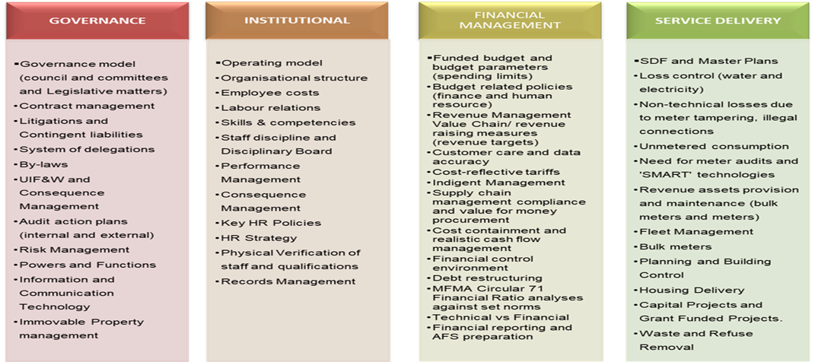
METHODOLOGY APPLIED (SUPPORT OF INTERVENTION)
To facilitate better/easier implementation and improve oversight and monitoring, the methodology used comprise the detailed technical assessment of the state of the municipality in terms of the four pillars of sustainability as detailed below. :-
8

Slide 9
THE MUNICIPAL SUPPORT AND INTERVENTIONS MODEL
The Budget Council of 2019 resolved that the Intergovernmental Relations division of the National Treasury should develop a credible programme of action to respond to the serious financial problems in municipalities. Concomitantly, the MFRS Unit was developed and implemented a new phased strategic approach that guides the development of financial recovery plans in municipalities. This approach consists of three phases namely:
RESCUE
Minimal set of key indicators across all four pillars necessary to neutralise financial turbulence (8 - 12months):
Focus is on cash and short -term liquidity: Funded Budget, Cost Containment, Cash Flow Management, Trading Debtors and collections, Creditor Management, Cash-backed CGs
Include service delivery projects with high visibility such as streetlights and potholes
Phase 1
STABILISATION
To address the underlying causes of failure focusing on eradicating problems at the root (12-24 months): In this phase as strong focus on cash, finances and financial management is still maintained but greater attention is placed on the underlying service delivery, governance and institutional matters perpetuating the financial crisis in the municipality“Plugging the holes and fixing the leaks” .
Phase 2
SUSTAINABILITY
To ensure financial and service delivery sustainability and prevent a regression (Subject to progress in Phase 2)
Phase 3
9

Slide 10
DIAGNOSTICS – MAFUBE CHALLENGES
Focus Area | Key Challenges
Pillar 1: Governance | Inadequate oversight over the progress on implementation of the Audit Action Plan (AAP) Delays in investigating UIF&W and inadequate consequence management Poor service delivery (Water and Sanitation Services, municipal road maintenance) | Poor contract management Poor litigation management Failure to pay creditors within 30 days Lack of by-law enforcement Ageing ICT infrastructure and inadequate maintenance of the same
Pillar 2: Institutional | The existing organogram was not costed. Overtime increased significantly between the FY2020/21 and FY2021/22 by 26.07%. The headcount (345 employees) is more than the recommended workforce by 131 employees. Local Labour Forum (LLF) not fully functional. Competences testing not cascaded to all the employees. | Performance reviews are not cascaded to all employees. Consequence management is not institutionalised. Most HR related policies are outdated. No regular verification of employees against payroll. Employees’ qualifications are not verified to determine their validity. No background checks are performed on employees.
Pillar 3: Financial Management | Outsourcing of the main source of revenue (sale of electricity). The billing system is not cleansed. Debtors book balance R861 725 443.10 as at 31 Jan 2023 of which 66.54% of the debtors are in the 3+ years category. | Non-compliance with SCM regulations and policies leading to irregular expenditure. Creditors balance was R 663 794 402.21 as at 31 January 2023 of which 90% of the creditors are in the 90 + days category. Misappropriation of grant funding.
Pillar 4: Service Delivery | Electricity debt of about R57 million with Eskom and about R58m with Rural Maintenance. Water debt of about R472m with Dept of Water and Sanitation. Underspending of capital grant funds. Rollover was declined. | High water losses of about 86% represents a major contributor to the current financial challenges. Poor Rural Maintenance (electricity) contract management. Ageing of infrastructure/Poor infrastructure maintenance.
10

Slide 11
THE ROLE OF MAFUBE LOCAL MUNICIPLITY
Council oversees the implementation
All decisions must in accordance with the set budget limits, objectives, key performance areas and set targets
01
No decision (Executive or Legislative) should be approved by Council, Executive Mayor and Accounting Officer that contravenes or defeats the FRP and its objectives and Council Portfolio and Standing Committees must be informed by the approved FRP
02
Council commitment and oversight support is critical for the successful implementation of the FRP to ensure that set turnaround targets i.e Revenue enhancement and turnaround times
03
11

Slide 12
MONITORING AND OVERSIGHT
1
2
3
4
Accounting Officer/ MM
Must submit the reports monthly to MFRS unit within the Provincial Treasury and the latter will report to NT.
NT/ PT MFRS
Conducts necessary quality assurance processes to verify performance
Confirms/certifies that decisions of the Council/EM/Mayor are consistent with the FRP
Oversight committee
must be established that meets monthly to deliberate on progress, participants should include relevant officials from the municipality, (the PT, Prov. CoGTA and Prov. SALGA, NT and National CoGTA)
Municipal Council will have a political oversight role
to review FRP implementation progress
12

Slide 13
ROLE OF THE COUNCIL
Council and the Executive Committee will be responsible to oversee the implementation of the approved and FRP
This FRP guides the executive and legislative authority of Council, the Executive Mayor and the Accounting Officer including the approval of the budget, legislative measures to give effect to the budget, ensuring that all decisions are consistent with the objectives, key performance areas, indicators and targets contained therein
It is advised, that no decision (Executive or Legislative) should be approved by Council, Executive Mayor and Accounting Officer that contravenes or defeats the FRP and its objectives
The recommendations of the Council Portfolio and Standing Committees must be informed by the approved FRP
13

Slide 14
FRP IMPLEMENTATION
Approved FRP
Oversight Committee
4 X Pillar Workstreams
Monthly and Quarterly Reporting
Institutionalization
Portfolio of Evidence
Strategic Alignment
Performance Management
14

Slide 15
INSTITUTIONALISATION OF FRP
The MM and heads of directorate must sign individual performance score-cares/ agreements for each financial year that incorporates the FRP.
The SDBIP and IDP must be revised for alignment with the FRP.
All monthly FRP reports must be tabled and discussed in monthly Top Management meetings
FRP progress report must be a standing agenda item for the meetings of Top Management, Executive Committee and Council
No decision (Executive, Legislative or Administrative) should be approved by Council, Executive Mayor and Accounting Officer that contravenes or defeats the FRP and its objectives
The MM must designate an official in his office to coordinate implementation and reporting on the FRP.
The MM must sign-off all FRP implementation progress reports before submission to NT MFRS, PT, Executive Committee and Council
15

Slide 16
KEY SUCCESS FACTORS OF FRP
Political Buy-in: Political problems need political solutions
Support from organised labour and general workforce
Link FRP activities to key financial outputs i.e. increasing revenue and deceasing expenditure.
Change Management
Identify and mobilise human and financial resources needed, and roles and responsibilities of other parties beside the municipality to implement the FRPs in terms of Section 142 of the MFMA.
Importance to address assurance level of claimed performance against FRP targets (POE).
Institutionalise IGR structure/steering committee to monitor implementation of FRP with TOR.
16

Slide 17
WAY FORWARD
In terms of section of section 146 of the MFMA wherein mandatory provincial intervention has been executed in line with section 139(a) and (c) of the MFMA, the municipality must refer to page 83 and 84 of the FRP and must further:
Implement approved FRP ;
Report monthly to the MEC for Finance on the implementation of the FRP.
2. The Roadmap has been implemented; however, the following must still be finalized (refer to compliance verification):
Institutionalize IGR Structure for FRP monitoring and oversight
Monthly progress reporting in accordance with the reporting framework IGR Structure (DCOG and NT)
Compile quarterly FRP assessment review reports on the intervention and send them to the Municipality, Minister of CoGTA, MECs Finance and CoGTA, FSPL, SALGA (Section 147 (1)(b) of the MFMA)
3. From administrative point of view, the following intervention approaches (Structures) should be considered:
Direct interventions – Placing an administrator in the municipality as additional resource together with specialists for each of the 4 Pillars (Financial Management, Service Delivery, Institutional Pillar, Governance/Strategy) (address the issue of the current Provincial Executive Representative (PER))
Indirect interventions - Providing support via existing mechanisms in terms of provincial functionaries e.g., Accounting Services, Budgets and Audit support to the municipality.
Hybrid approach - Appointing a dedicated panel of specialists (whether consultants or technical advisors) to support the municipality under the guidance of the FSPT.
4. The FRP is hereby submitted to the Council for noting.
17

Slide 18
END

